Slide 1

https://www.uni-goettingen.de/en/48115.html
Unless I explicitly state otherwise, images and cartoons are created using ChatGPT.
You may use this material free of charge under the terms of the CC BY license. This requires that you provide appropriate attribution to the author: W. Link, University of Goettingen, Germany.
In a few cases, individual images, photographs, or similar material may be subject to a more restrictive Creative Commons license. Where this applies, it is explicitly indicated, and you must comply with the stated license terms for those items.
Please check the license information carefully before reuse. Responsibility for complying with the applicable license terms rests entirely with you.
PopGen_Ch-7
Population Genetics; Δq = change of allele frequency q due to selection
1

Slide 2
Sequential Number: #8
UNPLAB-PopGen_Ch-7[Δq]
2

Slide 3

Keywords of this chapter :
Algebra:
3

Slide 4
I wrote this chapter just for fun and enjoyment. If you like, you can skip this chapter with almost no loss. However, anyone who also enjoys details and colourful curves is very welcome to follow the following considerations, derivations, illustrations, conclusion :-)
4

Slide 5
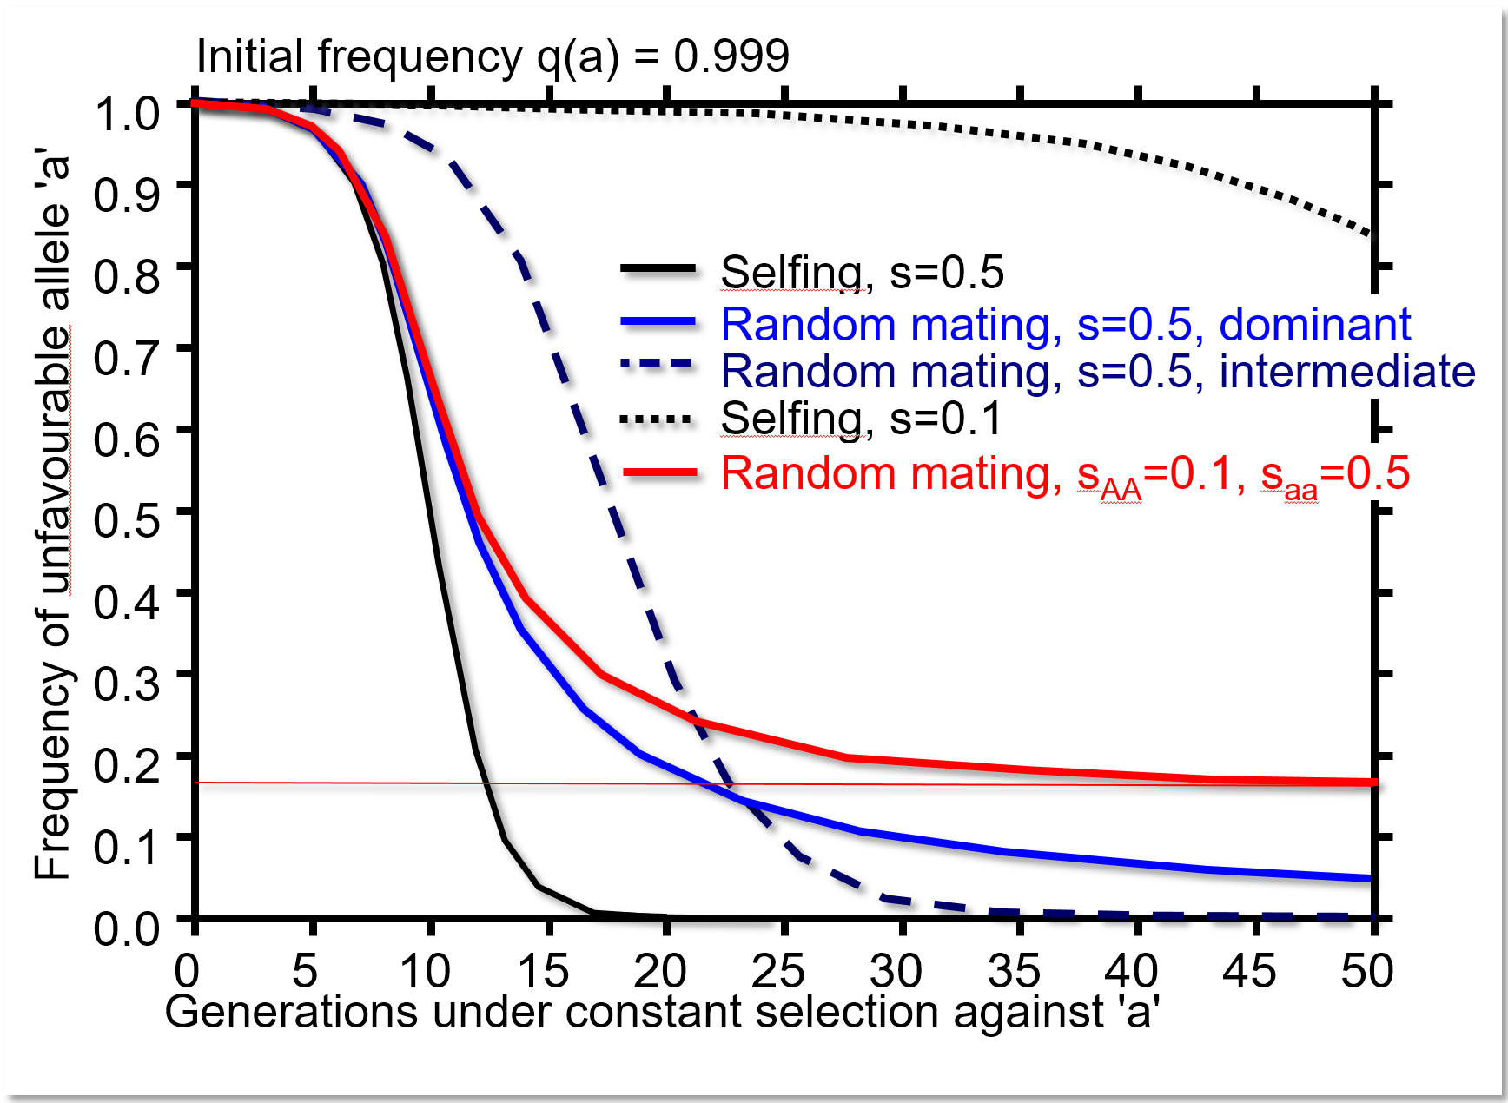
These ‚drop-down curves‘ … as they show the decrease in frequency of the unfavourable allele, implicitly show the increase in frequency of the favourable allele (only two alleles in our simple-way of thinking).
The drop of the curves is more or less steep; and is steep at smaller or at larger allele frequencies; and partly this depends on the size of s.
The selection coefficient s, as shown here (s=0.5 or s=0.1), is probably very rarely that large and probably is very small in nature and in phenotype-based selection, at least if we talk about polygenic traits (yield and
the like).
I was curious: What is the allele frequency
that causes the (relatively) largest, fastest
change in allele frequency - Δq(a) - if s was
very small?
overdominance
5
5

Slide 6
Algebra accompanies the diagrams you have seen
Visit Kent Holsingers‘s for details. https://www.researchgate.net/publication/267845714_Lecture_Notes_in_Population_Genetics
See George Acquaah, Chapter ‚Popu-lation Genetics‘
https://onlinelibrary.wiley.com/doi/epub/10.1002/9781118313718
The diagrams in the following pages begin with a focus on Random Mating & Complete Dominance.
You will not find these diagrams in text-books. I produced them ‘for fun’, to satisfy my curiosity and for the beauty of the curves.
I very much ;-) hope you too like such
‚Algebra-Visualizations‘
overdominance
6
6

Slide 7
On Y-axis you see the change (decrease) of the frequency of the unfavourable allele ‘a’.
There are two cases. Either the selection coefficient is small, s=0.1; or the allele ‘a’ is nearly lethal with s=0.98. The change Δq of its frequency in one step of selection is, correspondingly, very small or mostly quite large.
0.00
In addition to size of s, the actual allele frequency is important (see the X-axis). If q(a) is either zero or 100%, then there is of course no change. It is not easy to see at which initial frequency q₀(a) in case of s=0.1 we have the largest change Δq; somewhere between 0.5 < q₀(a) <0.8. Anyway, this ‘largest’ change is very small and never larger than Δq=-0.0156. We see that with s=0.98, the largest change is much larger and occurs at higher frequency (slighty above q₀(a) =0.9, the change then is Δq~-0.3893. Obviously, s influences the actual value of q₀(a) which results in the largest value of Δq.
Very probably this drop-down curve looks different if we assumed an intermediate type of gene action. Very probab-ly such curve looks again different if we assumed the population to be a landrace of a self-fertilizing species with no heterogygous genotypes.
-0.05
Dominant-recessive gene action
-0.10
Random Mating
-0.15
-0.20
s=0.10
Change of allele frequency
s=0.98
-0.25
-0.30
-0.35
-0.40
-0.45
-0.50
0.0
0.1
0.2
0.3
0.4
0.5
0.6
0.7
0.8
0.9
1.0
q
o
, allele frequency before selection
In the next pages we, hence, change these parameters: Selection coefficient s. Mode of reproduction. Frequency of unfavourable allele. Among other objectives, we will try to see: “When and where is Δq largest“ ?

Slide 8
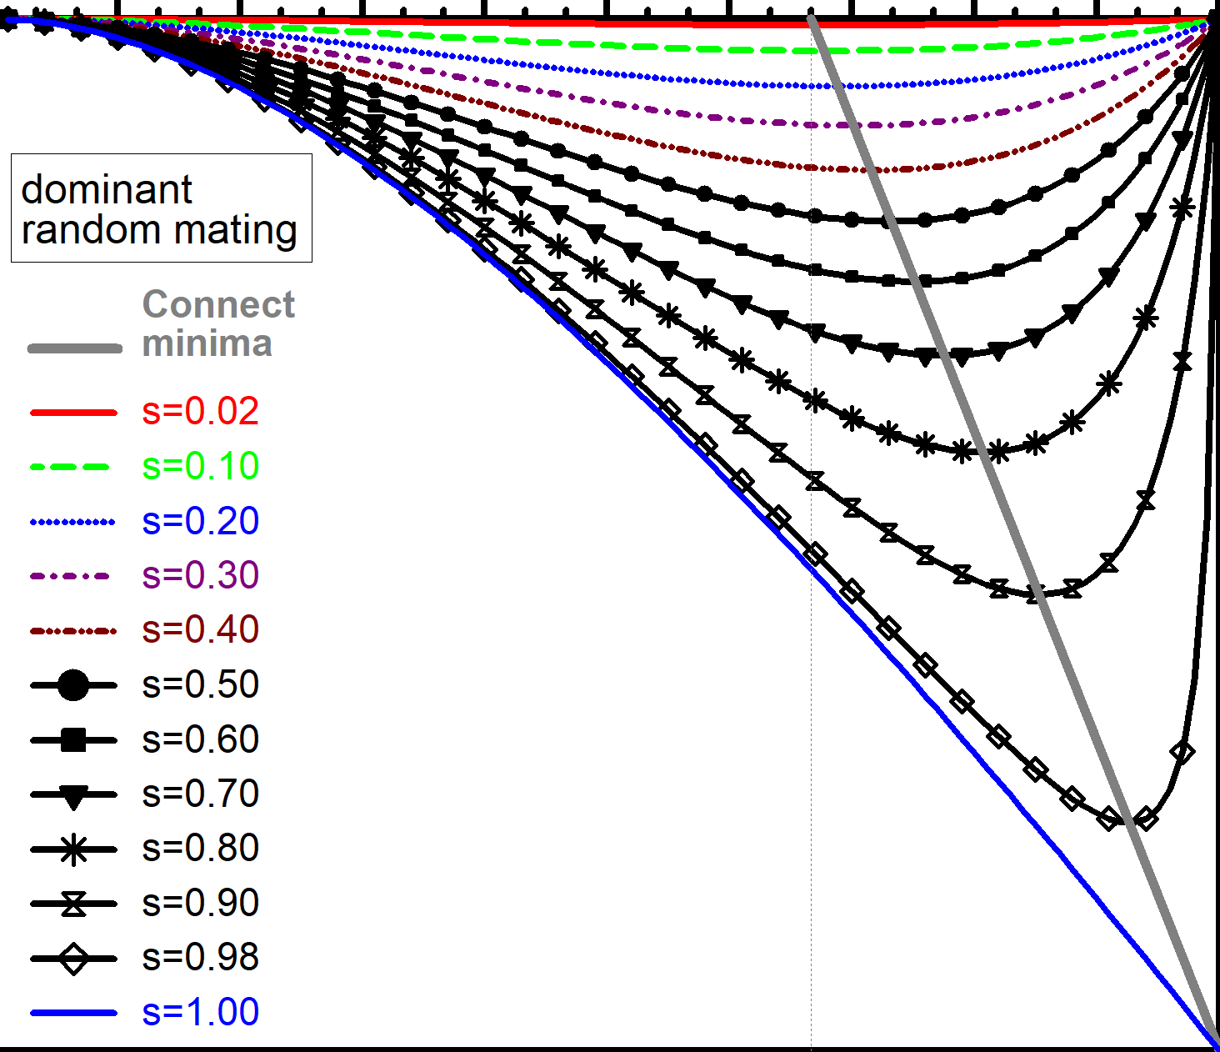
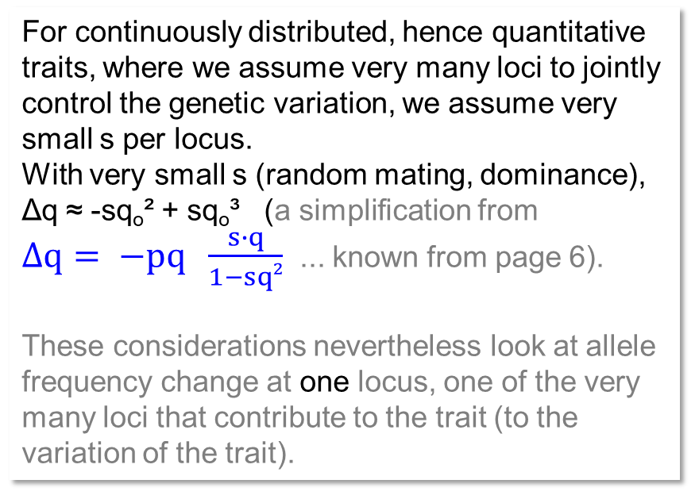
‘Where’ is the reduction (Δq) of the unfavourable allele ‚a‘ maximum (‘fastest’)?
0.00
For continuously distributed, hence quantitative traits, where we assume very many loci to jointly control the genetic variation, we assume very small s per locus.
With very small s (random mating, dominance),
Δq ≈ -sq_{o}² + sq_{o}³ (a simplification from
$Δq= −pq \frac{s∙q}{1−sq²}$ ... known from page 6).
These considerations nevertheless look at allele frequency change at one locus, one of the very many loci that contribute to the trait (to the variation of the trait).
-0.05
-0.10
-0.15
-0.20
Change Δq of allele a in this selection step
-0.25
Random mating,
dominance of A > a
-0.30
-0.35
-0.40
-0.45
See the greyish straight line connecting the minima.
-0.50
0.0
0.1
0.2
0.3
0.4
0.5
0.6
0.7
0.8
0.9
1.0
q₀(a); allele frequency before this selection step
Δq caused by one step of selection in a diploid, randomly mating population, dominance of favourable allele.
Different values of the selection coefficient s. Different frequencies 0 < q₀(a) < 1 before this step of selection.
8
8

Slide 9
‘Where’ is the reduction (Δq) of the unfavourable allele ‚a‘ maximum (‘fastest’)?
0.00
For continuously distributed, hence quantitative traits, where we assume very many loci to jointly control the genetic variation, we assume very small s per locus.
With very small s (random mating, dominance),
*Δq ≈ -sq_{o}² + sq_{o}³
This function has its maximum (negative) value at q₀(a) = ⅔ ; that value is very small, yet.
-0.05
-0.10
-0.15
-0.20
Change Δq of allele a in this selection step
-0.25
Random mating,
dominance of A > a
-0.30
-0.35
-0.40
-0.45
-0.50
0.0
0.1
0.2
0.3
0.4
0.5
0.6
0.7
0.8
0.9
1.0
q₀(a); allele frequency before this selection step
Δq caused by one step of selection in a diploid, randomly mating population, dominance of favourable allele.
Different values of the selection coefficient s. Different frequencies 0 < q₀(a) < 1 before this step of selection.
9
9

Slide 10
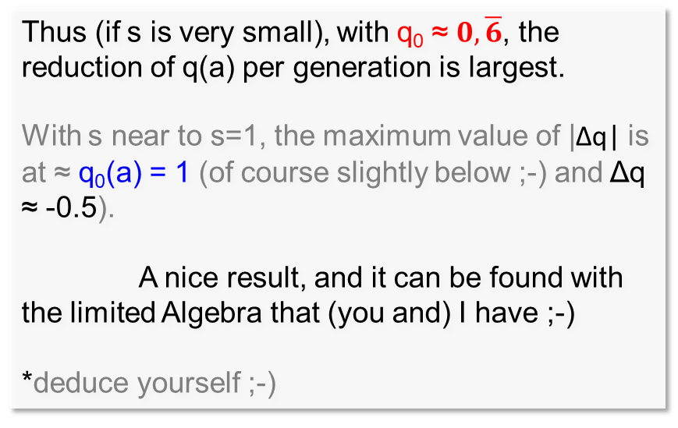
‘Where’ is Δq maximum? And … depending on what?
0.00
For continuously distributed, hence quantitative traits, where we assume very many loci to jointly control the genetic variation, we assume very small s per locus.
With very small s (random mating, dominance),
*Δq ≈ -sq_{o}² + sq_{o}³
This function has its maximum (negative) value at q₀(a) = ⅔ ; that value is very small, yet.
-0.05
-0.10
-0.15
-0.20
Change Δq of allele frequency q(a)
-0.25
Thus (if s is very small), with q₀ ≈ $0,\overline{6}$, the reduction of q(a) per generation is largest.
With s near to s=1, the maximum value of |Δq| is
at ≈ q₀(a) = 1 (of course slightly below ;-) and Δq ≈ -0.5).
A nice result, and it can be found with the limited Algebra that (you and) I have ;-)
*deduce yourself ;-)
Random mating,
dominance of A > a
-0.30
-0.35
-0.40
-0.45
-0.50
0.0
0.1
0.2
0.3
0.4
0.5
0.6
0.7
0.8
0.9
1.0
q₀(a); allele frequency before selection step
Δq caused by one step of selection in a diploid, randomly mating population, dominance of favourable allele.
Δq in this selection step is between very small and nearly -0.5, depending on s and on q₀.
10
10

Slide 11
‘Where’ is Δq maximum? Now for a self-fertilizing species.
Observe that now the Y-axis runs from 0 down to -1 (whereas one page before it was from 0 to
-0.5 only).
In black you find three cases from the previous page.
In red, you see (on y-axis) Δq(a) from one step of selection vs. (on x-axis) q₀(a); now for a strictly self-fertilizing population (‘Syrian landrace’).
… connect the q₀(a) at minima of the cases of s and extrapolate to smallest s values …
With very small s (selfing species),
maximum (negative) value of Δq now occurs at q₀(a) = ½.
With s near to s=1, the maximum value is near to q₀(a) = 1; and it actually is Δq(a) ≈ -1.0.
Mind: In just one step of selection, the change is from q₀(a)≈1.0 down to q₁(a)=0.0 .. woah!
0.00
-0.10
-0.20
-0.30
-0.40
Change of allele frequency
-0.50
s=0.30, dominant, random mating
-0.60
s=0.90, dominant, random mating
s=1.00, dominant, random mating
-0.70
s=0.30, selfing
s=0.90, selfing
-0.80
s=1.00, selfing
-0.90
-1.00
0.0
0.1
0.2
0.3
0.4
0.5
0.6
0.7
0.8
0.9
1.0
q₀(a), allele frequency before selection
11
11

Slide 12
‘Where’ is Δq maximum? And … depending on what?
0.00
With s near to s=1, the maximum value is near to q₀(a) = 1; and it actually is Δq(a) ≈ 1.0.
.. woah!
¿Está claro?
Assume the unfavourable allele ‘a’ is frequent: all N>10 000 (anyway homozygous) individuals are ‘aa’ except one mutant which is ‘AA’. Now, at a sudden, a new deadly threat occurs, all ‘aa’ are condemned to stay without offspring. The ‘AA’ type alone has offspring, all future members of the population will trace back to that genotype.
Thus, q(a) jumps from >99.99% down to 0% in just one generation (yes yes, we ignore all trouble by inbreeding and whether the ‘AA’ was self-compatible at all and so on; and we politely overlook the fact that the rare ‘AA’ mutant was already homozygous yet still alone ...).
-0.10
-0.20
-0.30
-0.40
Change of allele frequency
-0.50
s=0.30, dominant, random mating
-0.60
s=0.90, dominant, random mating
s=1.00, dominant, random mating
-0.70
s=0.30, selfing
s=0.90, selfing
-0.80
s=1.00, selfing
-0.90
-1.00
0.0
0.1
0.2
0.3
0.4
0.5
0.6
0.7
0.8
0.9
1.0
q₀(a), allele frequency before selection
12
12

Slide 13
‘Where’ is Δq maximum? Random mating and intermediate gene action.
Here, in blue, we compare what we have seen before with the third situation:
random mating and intermediate gene action (phenotype of Aa exactly in-between AA and aa).
From the diagram, you discover for this case (connect minima, extrapolate ...):
With very small s, maximum (negative) value of Δq occurs at q₀(a) = ½. With s near to s=1, the maximum value is at q₀(a) ≈ 1 (both findings are as in the case of selfing); yet the values Δq(a) differ from that case! With s=1 and at q₀(a) ≈ 1,
❖ here Δq(a) ≈ -0.5.
If q(a) ≈ 1, then nearly all alleles ‘A’ occur in Aa heterozygotes, and with s=1, these are the only ones who will survive the ‘sudden deadly threat’, although with medi-ocre fitness. They contain A and a with p=q=0.5 frequencies. Voilà.
❖
0.5
1.0
q₀,
13
13

Slide 14
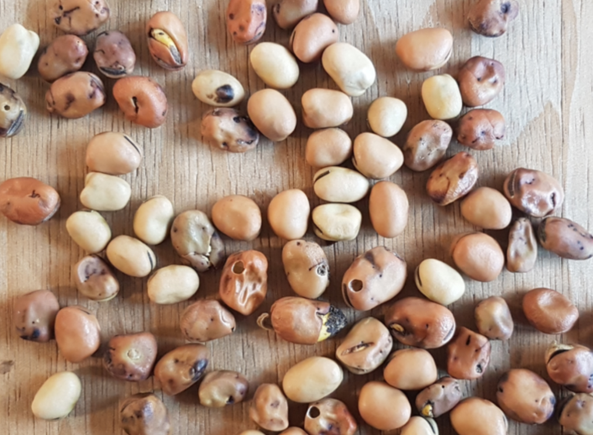
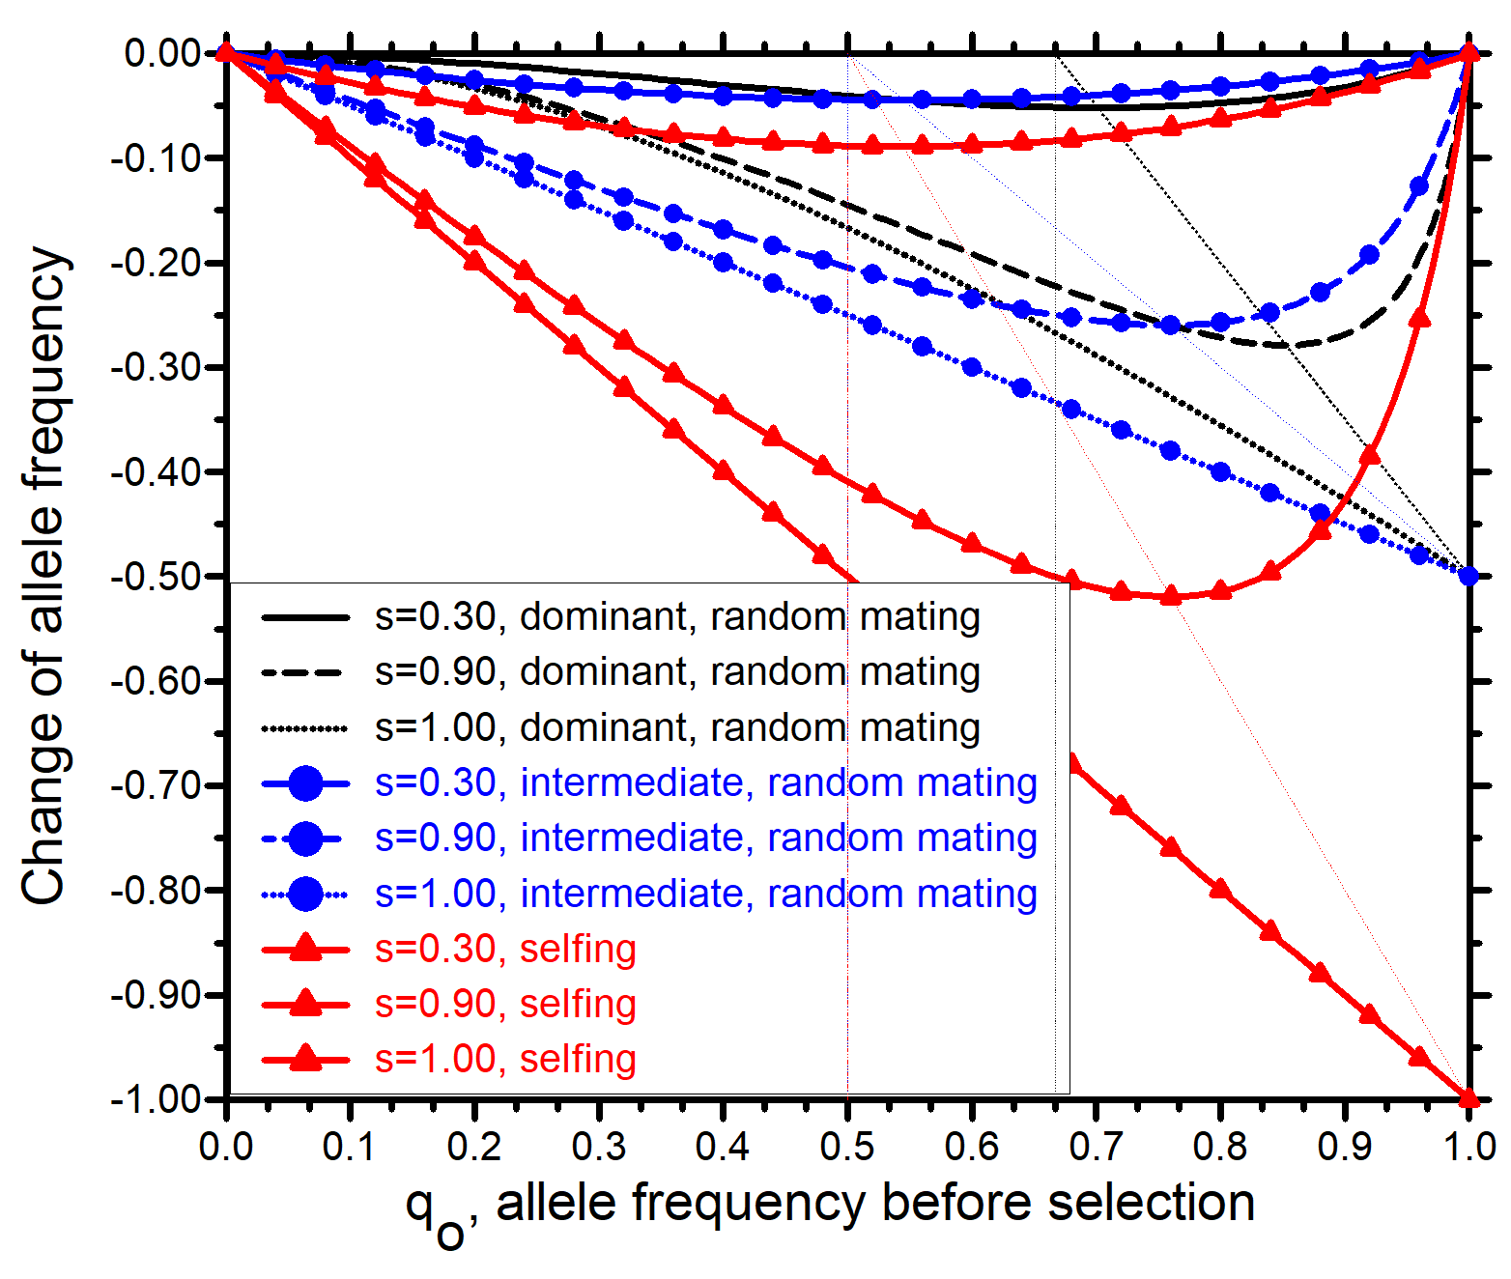
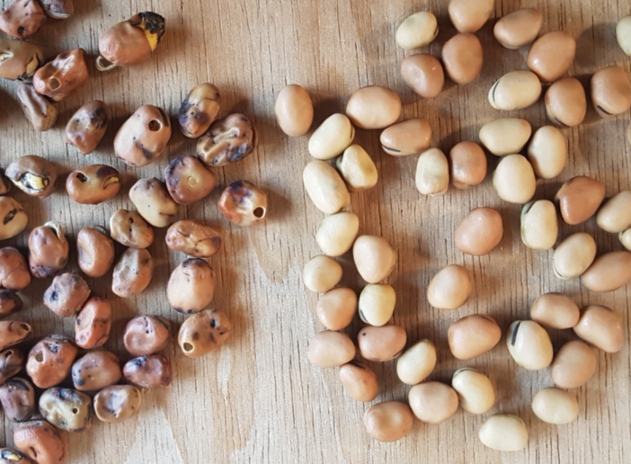
Rehearsal
© SY
Maximize the result of one step of mass selection! To do so, choose your crop species’ reproductive mode. Choose the trait to work with, according to predominant gene action. What is your choice then? Rather choose maize (outcrossing crop) or barley (selfing)? Rather choose grain yield (more dominant-recessive gene action) or protein digestibility (more intermediate gene action)? Rather favour a mono- or a oligo- or a poly-genic trait? What should be the typical allele frequency at the loci of such trait ... to allow large gain from one step of mass selection?
14
14

Slide 15
Sum up, rehearsal of what we have seen …
Maximize the result of one step of mass selection! To do so, choose your crop species’ reproductive mode. Choose the trait to work with, according to predominant gene action. What is your choice then? Rather choose maize (outcrossing crop) or barley (selfing)? Rather choose grain yield (more dominant-recessive gene action) or protein digestibility (more intermediate gene action)? Rather favour a mono- or a oligo – or a polygenic trait? What should be the typical allele frequency at the loci of such trait ... to allow large gain from one step of selection?
The selection coefficient s should be large, this is more probably true in mono- or oligogenic traits than in polygenic traits.
Δq should be large, this is more probable in self-fertilizing crops than in cross-fertilizing crops.
Δq should be large. If ‚random-mating‘ and ‚a‘ is recessive, then Δq is larger at quite high frequencies of ‚a‘; whereas if ‚a‘ is intermediate, Δq will be larger at somewhat lower frequencies // even better if the ‚bad‘ allele was dominant ;-)
If s per locus is very small, and if we have random mating and dominance of good alleles: Then allele frequencies of the unfavourable alleles should be at p=⅔. If gene action is intermediate (random mating) or if we have anyway self-fertilization, then allele frequency of ‚a‘ should be p=½.
15
15

Slide 16
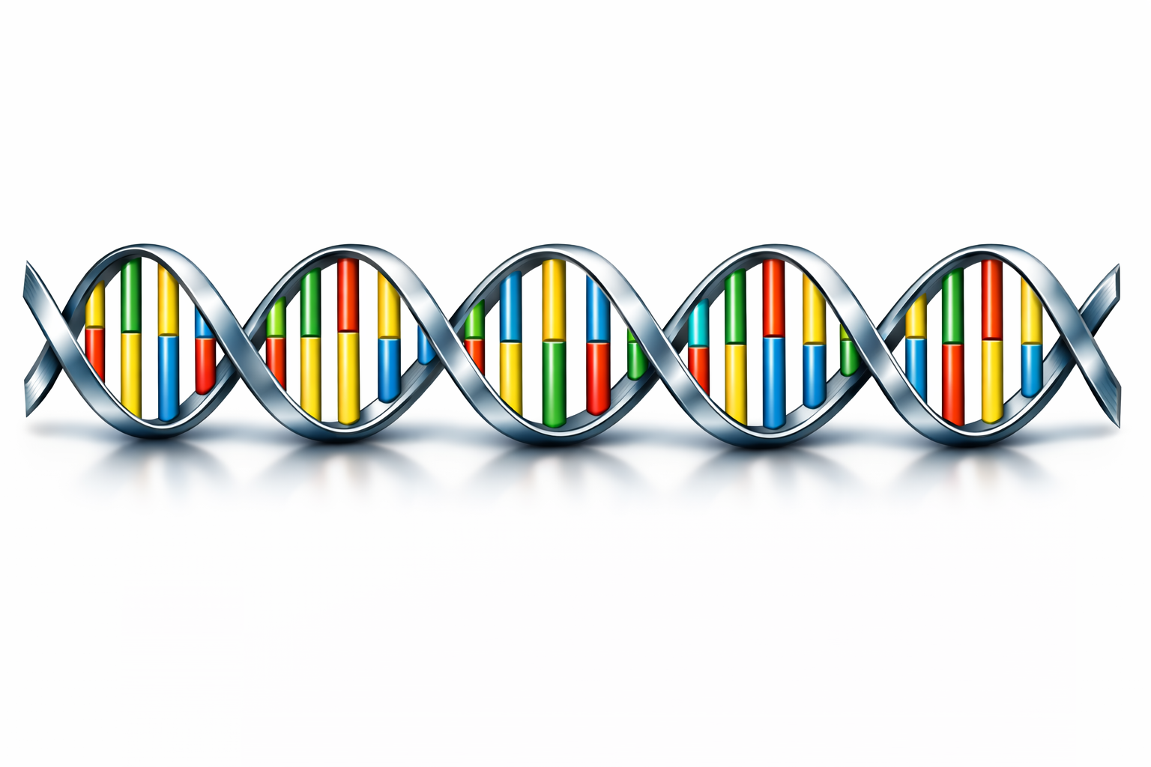
From here you may go to UNPLAB-PopGen_Ch-8[Equil]
What is changed if we do not exert Selection pressure on one locus that participates in the ‘making’ of a quantitative trait and we (or nature) select based on the trait expression ...
but we exert direct Selection pressure on that locus and its alleles ... because we know the DNA sequence of these alleles and we can get DNA data of all our candidates? The current default marker type, SNP, is codominant. There is no issue any more with “recessive allele can not be detected in heterozygous genotype”. Will, in this case, the difference in Δq between ‚Random Mating‘ and ‚Self-fertilization‘ vanish?
Think for yourself about it. What you discover yourself is much better-understood and brings more fun.
With ChatGPT. This LLM was ($19/02/2026 16:13$) seemingly not well informed about two purine bases and two pyrimidine bases and the mating (pairing) pattern among them ;-)
16
16

